Slide 1

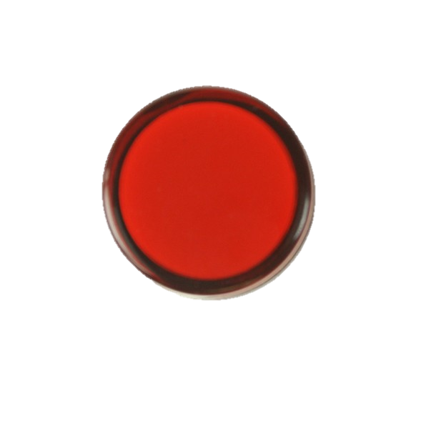
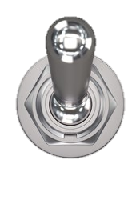

5V
3V3
Bus Output LEDs
Bus Switches
5V
BUS
5V_LUP
BUS
3V3
BUS
3V3_LUP
BUS
Regulator Output LEDs
Regulator Outputs
5V Switching Regulator
3V3 Switching Regulator
Regulator +
Enable Switches
5V EN
3V3 EN
Reverse-polarity protection
Reverse-polarity protection
Can be shorted to function off one supply
Regulator Inputs

